Slide 1

EasyTrage
Team Trage:
Mike Hamilton (initial Scrum Master),
Kevin Lee,
Abdul Mohamed
Vikram Melkote (Product Owner)
Christopher Kong
3/11/2018

Slide 2
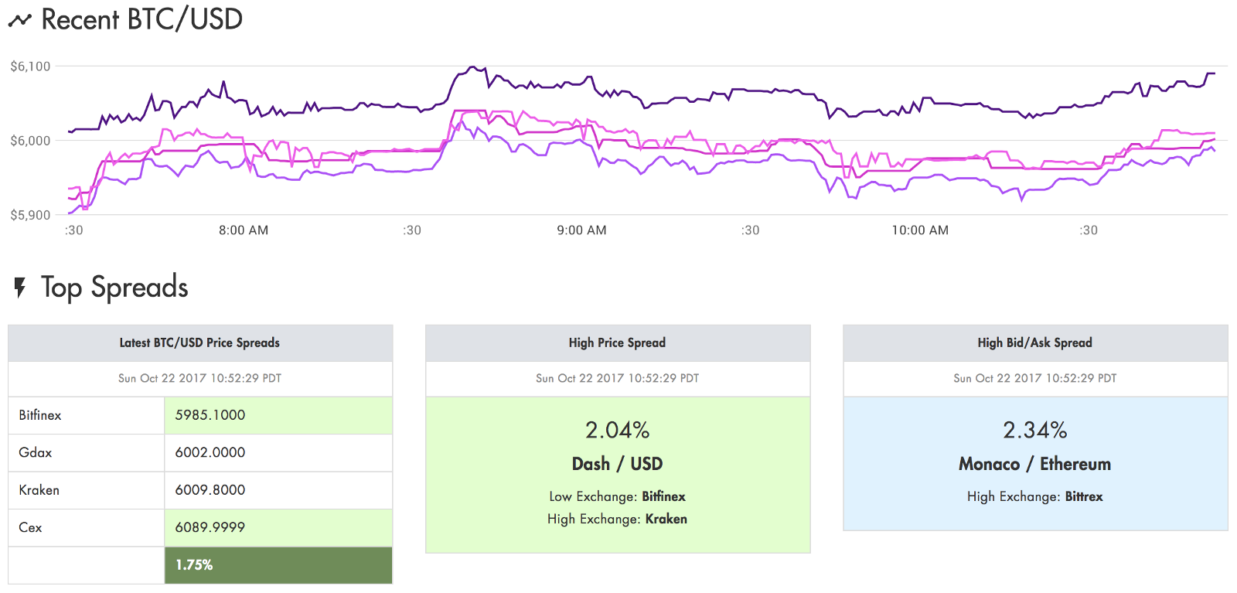
Motivation
In the Crypto world there are a lot of different cryptocurrency exchanges that allow users to trade different digital assets for their native currency as well as other digital assets.
Whenever the prices of one or more cryptocurrencies plunges or has a run up, there is often a lag in price movement between different exchanges, especially ones hosted in different countries. We want to build a bot that capitalizes on this.
Notes:
Vikram

Slide 3
Goals
Create a website that is capable of trading cryptocurrencies/suggesting trades through different exchanges
Has the ability to compare prices, trade fees and withdrawal fees on different exchanges to find out which trades are profitable.
Displays the discrepancies between exchanges
Login and sign-up functionality with history data for trades through the api.
Notes:
Vikram

Slide 4
Goals We Achieved
Authenticated login system
Up to date coin price data
Compare prices and fees on different exchanges to find out which trades are profitable.
Automated trade suggestions that factor in trade fees and withdrawal fees
Notes:
Christopher

Slide 5
Goals We Did Not Achieve
Automated Trading (soon)
Visualization of past trade profit / loss
Trade history (soon)
2 factor authentication
Multiple coins
Notes:
Christopher

Slide 6
Challenges
Product Standardizing and aggregating data from many exchanges Temporary bans from rate limiting Automated trading using API’s Setting up docker Connecting React, Mongo, and Express | Process Time management Conflicting time schedules Waking up early

Slide 7





Technologies
React - Front end framework to handle templating/ HTML generation, displaying data from web server to user
mongoDB - database for storing usernames, emails, hashed passwords, API keys, and other persistent site data
Node.js + Express.js - Back end / server side frameworks for interacting with other API servers of exchanges, checking prices, performing calculations routinely to look for trades, etc
Docker - containerizing developer tool so that we don’t have the “it works on mine” problem, and if we want to deploy it, the deployment environment will be the same as the development environment
+
Notes:
Docker - vm-like containers which run all necessary software for the server-side in it’s own lightweight OS which eliminates issues caused by cross-platform development/deployment

Slide 8

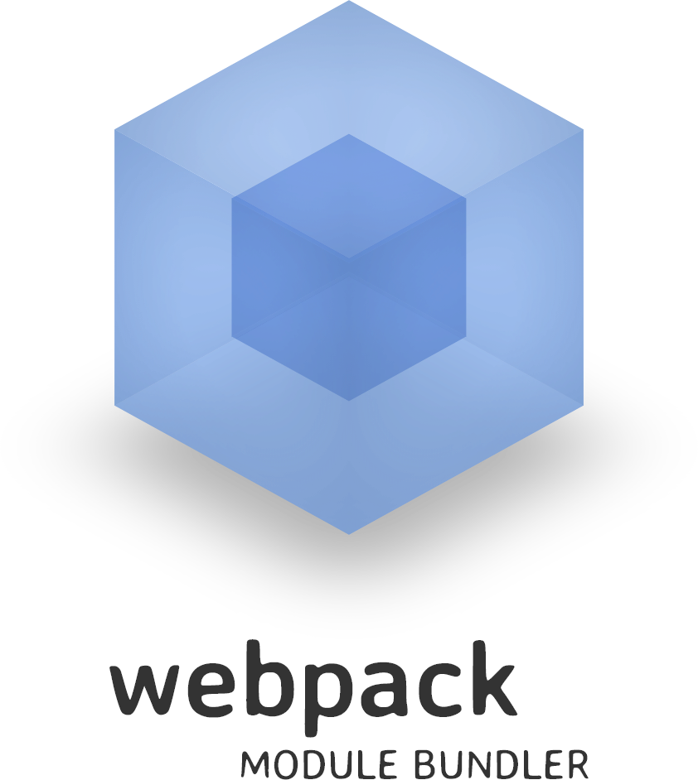



Architecture
Backend: Server + Database
+
Front-End Framework
(client)
Client
...
Exchange APIs
Notes:
Client interacts with front-end to make an account, input exchange info, see data, etc
Dockerized (vm-like container) Back-end communicates with exchange APIs to check prices and calculate profitable trades (maybe also execute trades)
Express.js/node.js API/server communicates with mongoDB to store user data upon registration, trade, etc
Back-end (express server) communicates its data to client upon request
React.js client side application renders components as necessary and let’s client interact with the application

Slide 9
Notes:
Login Validation - Christopher

Slide 10
Notes:
Successful registration - Christopher

Slide 11
Notes:
Prices -

Slide 12
Notes:
Adding new api key in settings -

Slide 13
Notes:
Showing settings persist -

Slide 14
Notes:
Suggested trades -

Slide 15
Notes:
Suggested trades static

Slide 16
Notes:
Showing trade modals - Vikram

Slide 17
Notes:
Trade modal static - Vikram

Slide 18
Notes:
Trade simulation - Vikram

Slide 19
Notes:
Post trade simulation static - Vikram

Slide 20
Notes:
api/price -

Slide 21
Notes:
api/price/pair -

Slide 22
Notes:
api/price/pair/exchange -

Slide 23
Notes:
api/suggestions -

Slide 24
Project Management Techniques
Scheduled team coding sessions multiple times a week
Discord to stay connected and up to date
Scrum meetings
Automated Github notifications
Trello

Slide 25
What we enjoyed /
Didn’t enjoy
Enjoyed Working with crypto Seeing profits When things worked | Didn’t enjoy Docker Rate limiting bans Steep learning curve React lifecycle

Slide 26
Lessons Learned
What worked Team coding sessions Pair programming | What we wish we did More Code reviews More coding sessions earlier

Slide 27
Questions?

